Slide 1

Getting Started

Slide 2
Learning Objectives
Become conversant in building and executing WRDS web queries.

Slide 3
What is WRDS?
WRDS stands for Wharton Research Data Services.
WRDS aggregates data into a standard format and then makes it available to subscribers.

Slide 4
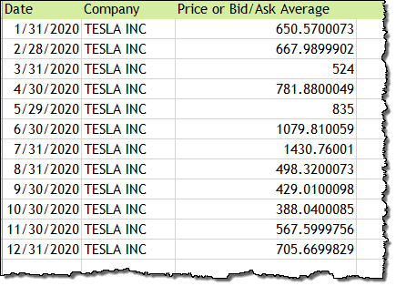
Financial Data
WRDS is best known for financial data—for example, stock prices from CRSP, or company fundamentals from Compustat.

Slide 5
Other Types of Data
WRDS also hosts data in a variety of other disciplines including:
Accounting
Banking
Economics
Healthcare
Insurance
Management
Marketing

Slide 6
Getting Started
All you need is a web browser and Internet access to query data from WRDS.
After you decide which dataset to use, you can use the web-based query form to extract and output data in the format of your choice.
The following assignment provides instructions on how to create a web-based query. See Support for additional ways to access WRDS data.

Slide 7
Link to WRDS
https://wrds-www.wharton.upenn.edu

Slide 8
Class Account Information
If you are using a class account to access WRDS, please ask your instructor for the class login credentials.
Do not share this information outside the class.

Slide 9
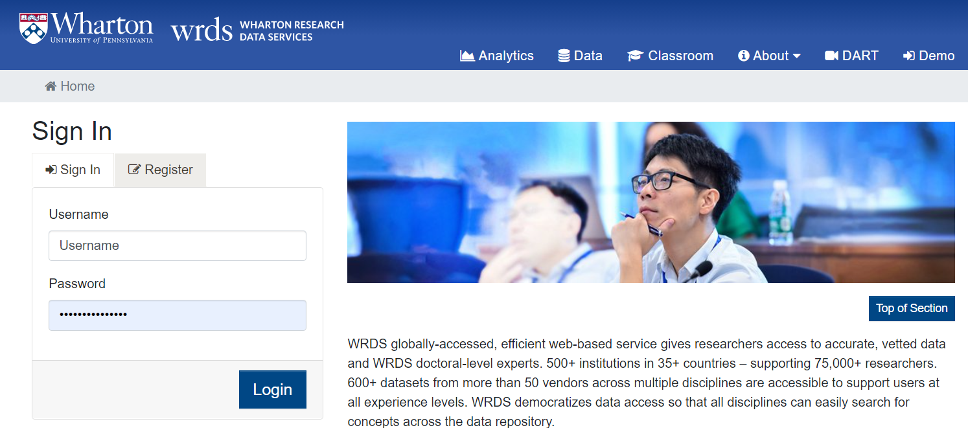
WRDS Login Page
Enter your username and password.
Click the Login button.

Slide 10
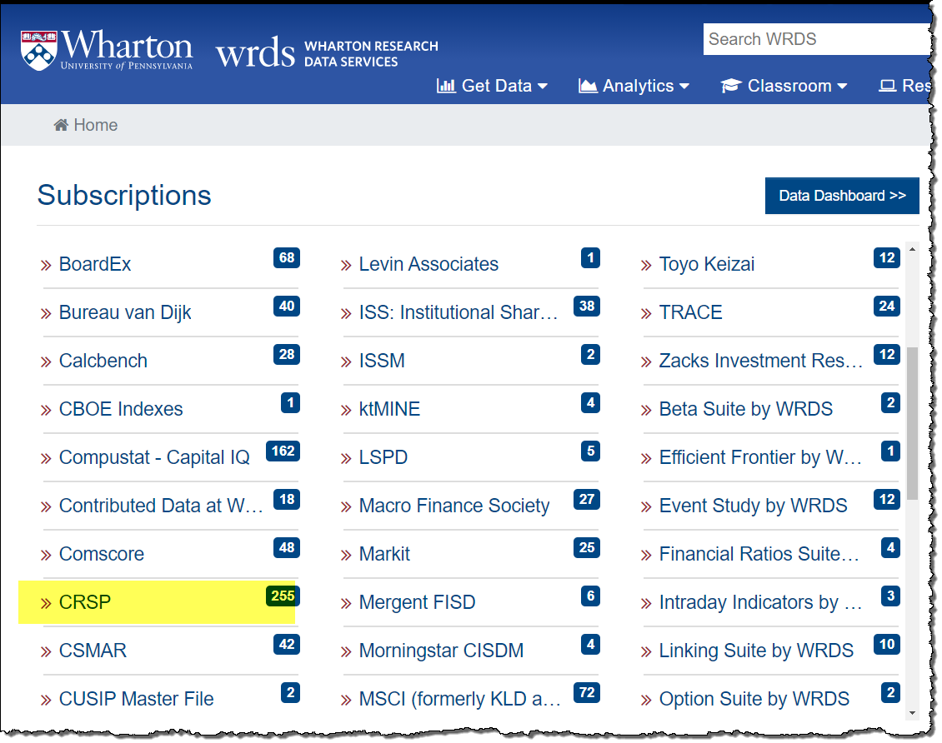
WRDS Home Page
The WRDS Home page displays your data subscriptions.
Scroll down the page to locate the CRSP dataset.
Click on CRSP.

Slide 11
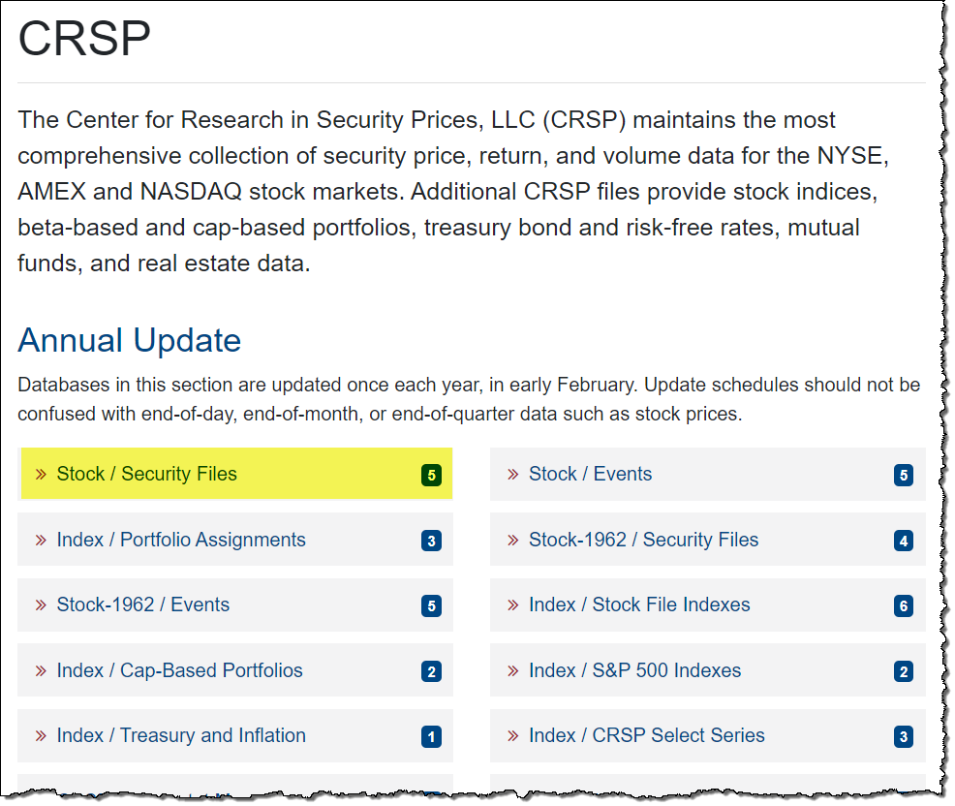
CRSP Page
Click on Stock/Security Files.

Slide 12
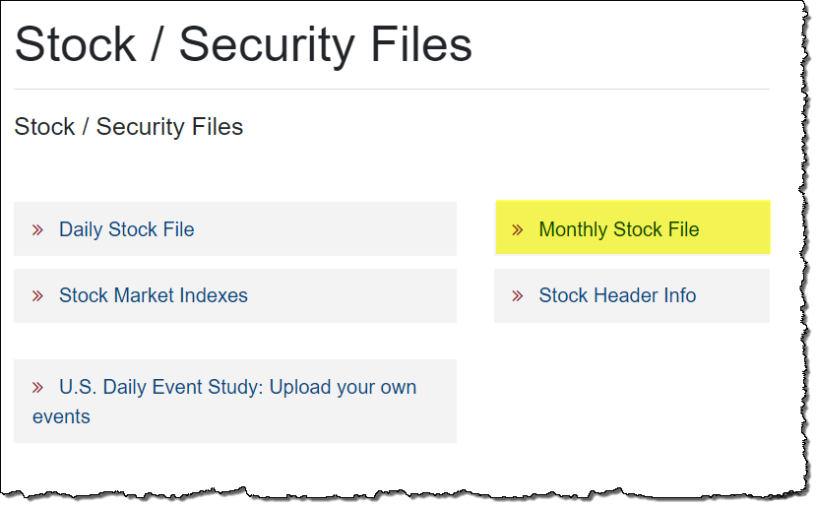
CRSP Stock/Security Files Page
Click on Monthly Stock File.

Slide 13
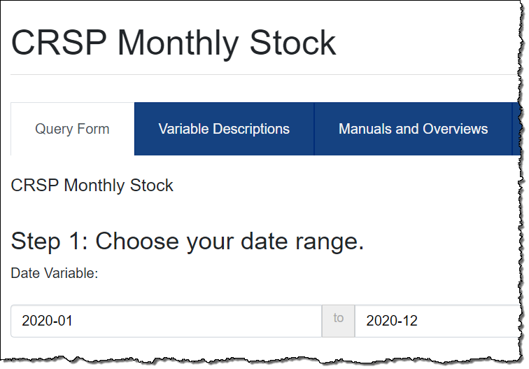
CRSP Monthly Stock Data Query
On the query page, the first step is to select the date range for your data.
Enter 2020-01 to 2020-12 in the Date Variable fields.

Slide 14
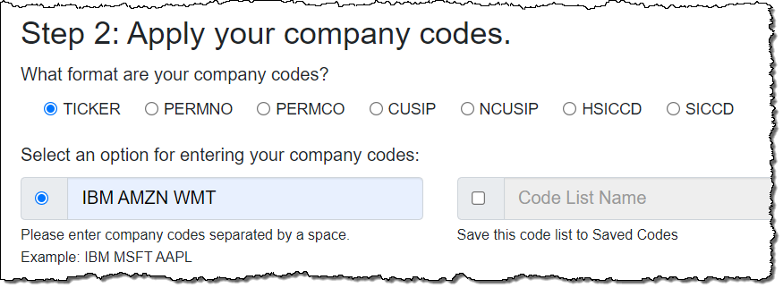
Enter the Companies
Make sure Ticker is selected.
Enter the ticker symbols for the companies: IBM AMZN WMT.

Slide 15
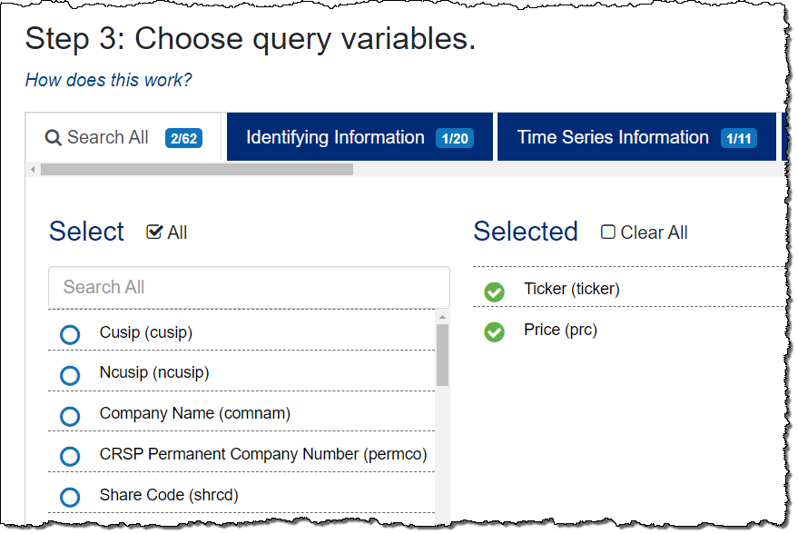
Select the Query Variables
Select the variables you want from the Query Variables list.
For this assignment, select two variables: Ticker and Price.

Slide 16
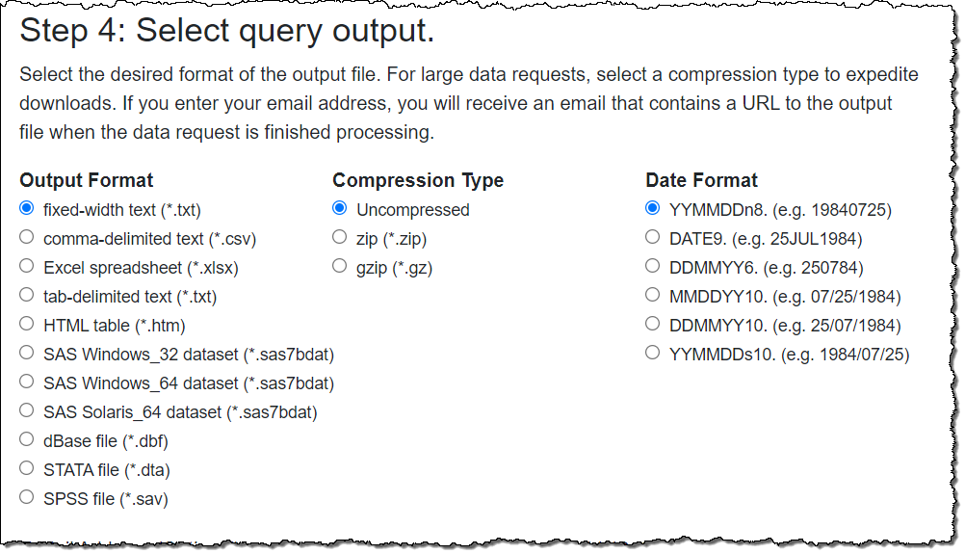
Select the Query Output Format
For this assignment, select fixed-width text (*.txt), which will display the data in your browser.

Slide 17
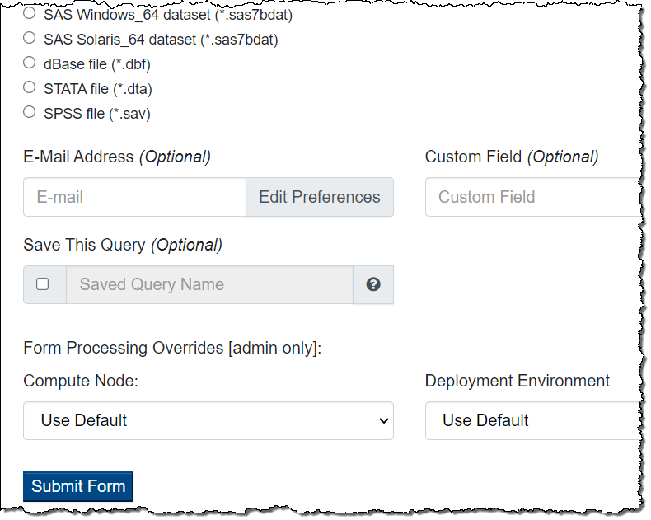
Run the Query
Click the Submit Form button at the bottom of the page to run the query.

Slide 18
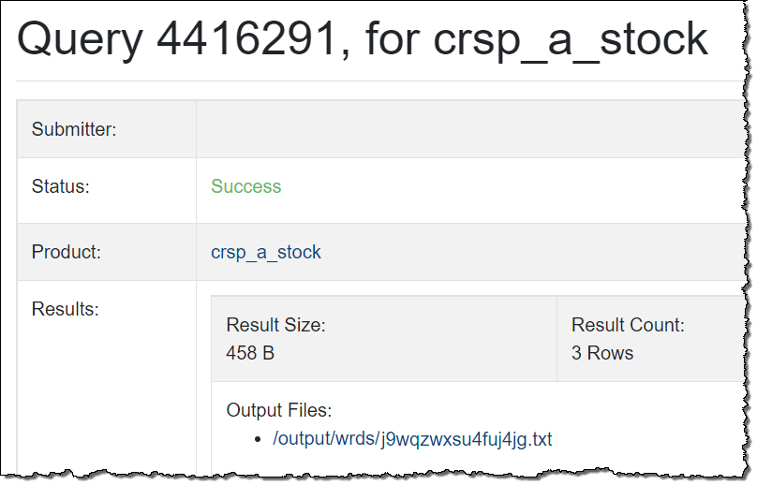
A summary page opens in a new tab, indicating the status of your query, and containing the link to your results.
“Success” means your data is ready.
Query Summary
Click the Output Files link to access the results of your query.

Slide 19
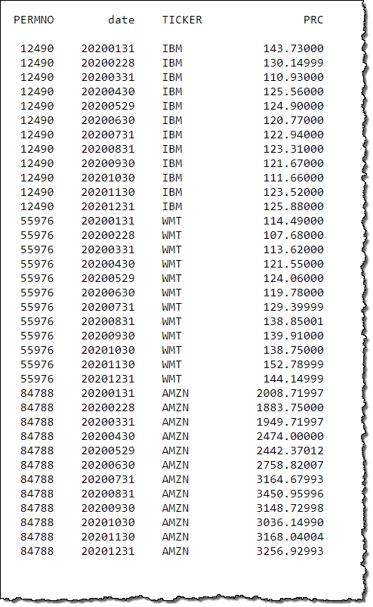
Query Results
The monthly stock prices for IBM, Amazon, and Walmart for 2020 are displayed.

Slide 20
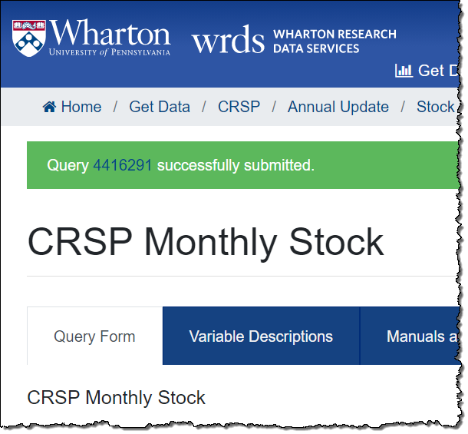
Note: Pop-Up Blocker Installed?
If you have a pop-up blocker on your browser, the query page will show a banner indicating the query was submitted.
Click the query number to proceed to the Summary screen, then click the link to access your results.

Slide 21
Additional Help
For any questions, please contact: https://wrds-www.wharton.upenn.edu/contact-support/

